Slide 1
SECURE DATA HIDING IN IMAGES USING STEGANOGRAPHY
CAPSTONE PROJECT
Presented By: Vaishnavi Dnyaneshwar Mahalkar
Student Name: Vaishnavi Dnyaneshwar Mahalkar
College Name & Department : Maharashtra Institude of Technology (Emerging Science and Technology)

Slide 2
OUTLINE
Problem Statement
Technology used
Wow factor
End users
Result
Conclusion
Git-hub Link
Future scope

Slide 3
Problem Statement
With the rise of digital communication, ensuring data security is crucial. Traditional encryption methods are often detectable, making them vulnerable to attacks. This project focuses on secure data hiding in images using steganography, where confidential information is embedded within images to prevent unauthorized access. The goal is to develop an efficient and undetectable technique that enhances data confidentiality while maintaining image quality.

Slide 4
Technology used
Language: Python
GUI: Tkinter, ttk
Image Processing: OpenCV, Pillow
Steganography: Pixel Manipulation, LSB Technique
Security: Passcode Protection, Python Dictionaries
Hardware: 4GB+ RAM, Intel i3+, 500MB+ Storage

Slide 5
Wow factors
Unique Features of the Project
Secure Data Hiding – Uses pixel manipulation & LSB technique to embed messages secretly.
User-Friendly GUI – Simple Tkinter-based interface for easy encoding & decoding.
Passcode Protection – Ensures only authorized users can retrieve hidden data.
Multi-Format Support – Works with various image formats (PNG, JPG, BMP, etc.).
Lightweight & Fast – Efficient image processing with OpenCV & Pillow for quick execution.
Low System Requirements – Runs smoothly on basic hardware (4GB RAM, Intel i3+ CPU).
Open-Source & Customizable – Code can be modified for different security applications.

Slide 6
End users
Secure Communication – Individuals & organizations needing private message exchange.
Cybersecurity Professionals – Used for covert data transmission & security research.
Intelligence Agencies – Helps in confidential data storage & secret communication.
Government & Defense – Useful for secure exchange of classified information.
Data Protection Experts – Assists in preventing unauthorized access to sensitive data.
Ethical Hackers & Researchers – Helps in testing & improving steganography techniques.

Slide 7
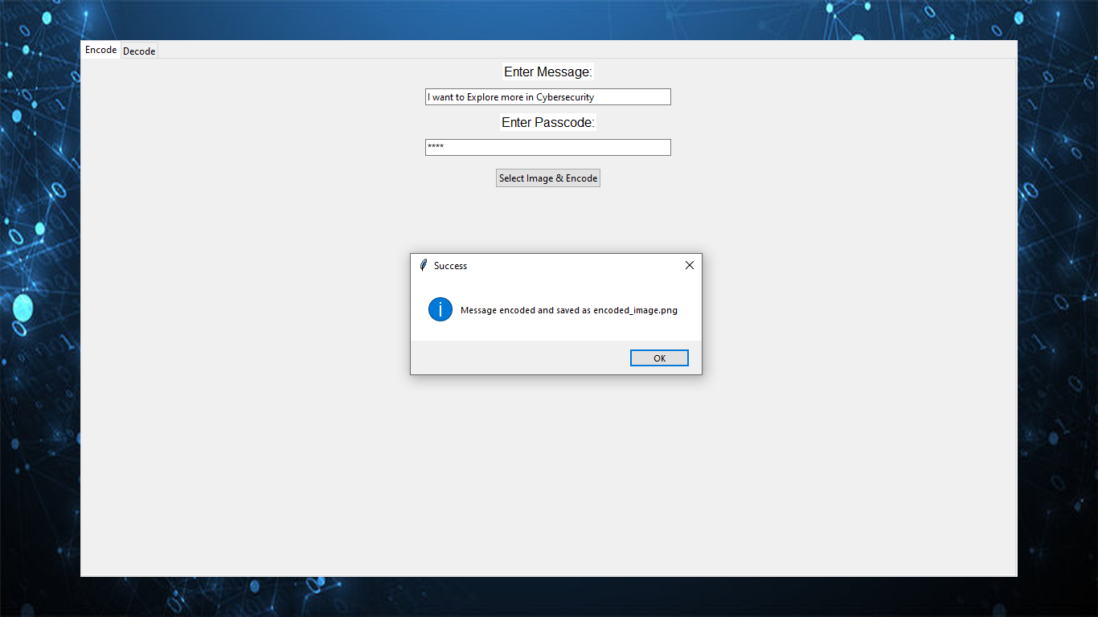

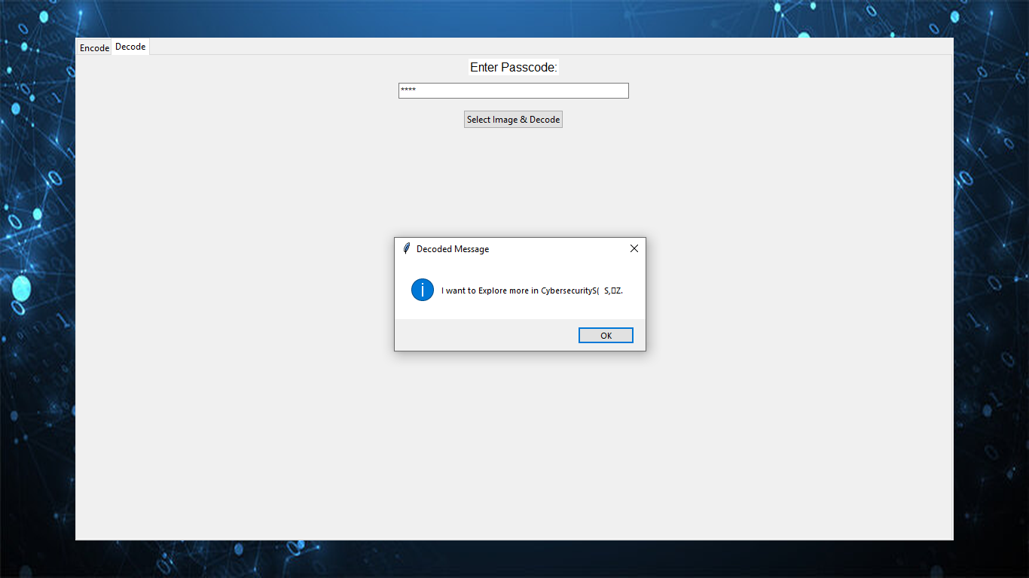
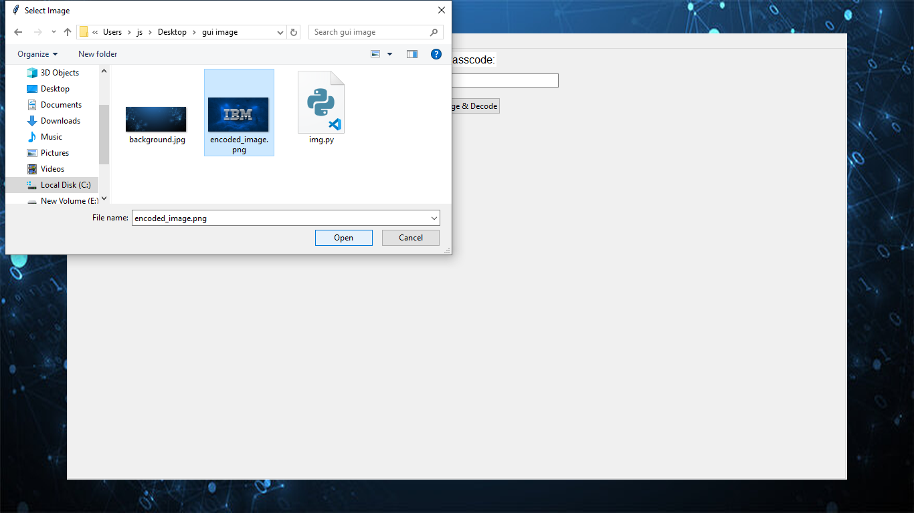
Results
GUI of Project

Slide 8
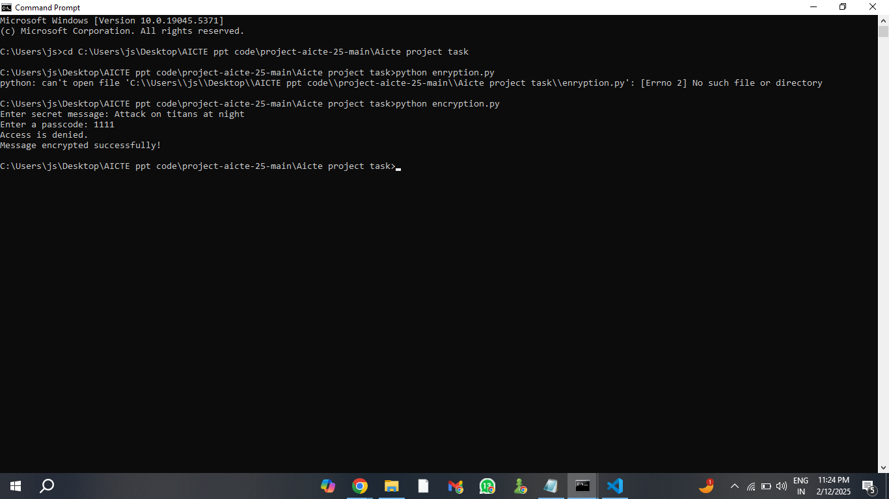
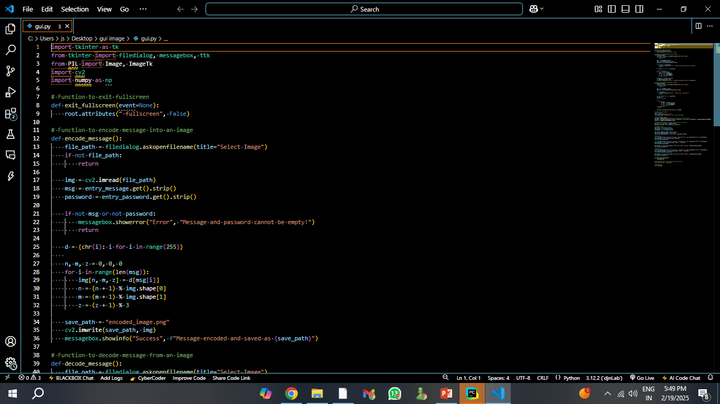
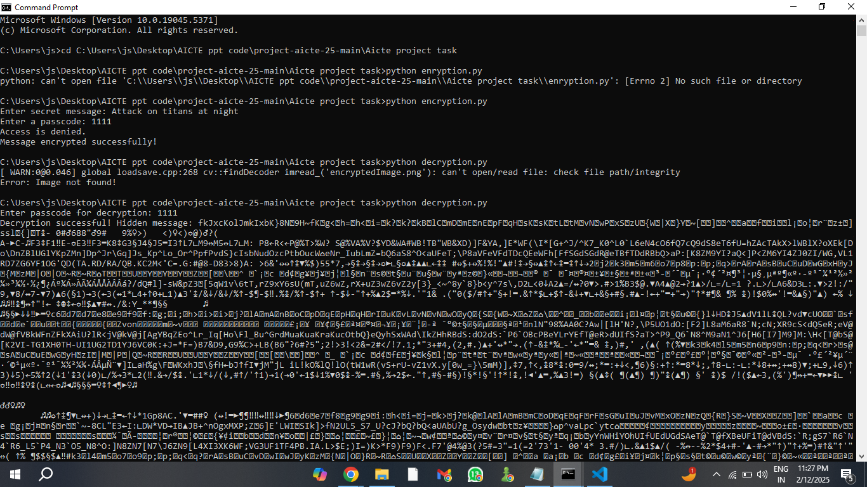
Results

Slide 9
Conclusion
This project enables secure data hiding in images using steganography.
Passcode protection ensures only authorized users can decode messages.
A simple GUI makes encoding & decoding user-friendly and efficient.
Useful for cybersecurity, secure communication, and data protection.
Can be enhanced with encryption & AI for stronger security.

Slide 10
GitHub Link
https://github.com/Mahalkar/steganography.git

Slide 11
Future scope(optional)
Advanced Encryption – Implement stronger cryptographic techniques for enhanced security.
Video & Audio Steganography – Expand data hiding capabilities beyond images.
AI-Powered Detection – Use machine learning to identify and prevent steganography misuse.
Cloud & Blockchain Integration – Enable secure and decentralized data hiding.
Cross-Platform Support – Develop mobile and web applications for wider accessibility.

Slide 12
THANK YOU

